Slide 1
All Me!
By: Alexis Teves
BC3

Slide 2
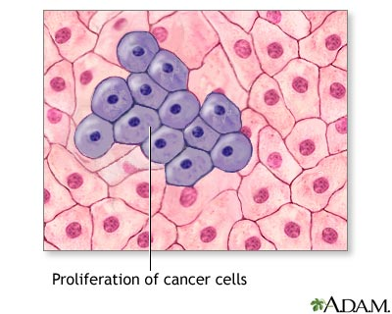
Most Important…
What I want to do???
When I get out of school I want to check for cancer cells. But before I get out of school I am going to the Capital Area Career Center to study Histotechnology or be a Histologist.

Slide 3
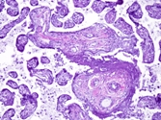
What is Histotechnology?
Histotechnology is the preparation of tissue for examination under a microscope, as a field of study and practice. Which is what the Histologist does. The specialty subject within the profession of Biomedical Science, is often called Medical Laboratory Science or Medical Laboratory Technology.

Slide 4
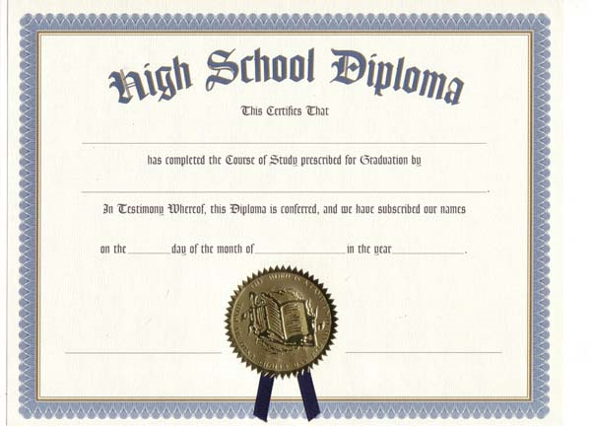
What I have to have in order to do my career
Since I am interested in being a Histologist. The High school courses I should take are algebra, geometry, biology, chemistry, physics, computer skills, English, health occupations or medical professions education, and physical education. I also have to have a high school diploma or equivalent.

Slide 5
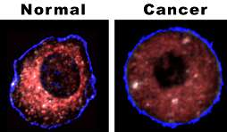
Before I actually get the job
People interested in the career they must first obtain a baccalaureate degree in Histotechnology or an approved major. They must then receive at least one year of training in a histopathology laboratory under a certified pathologist. In addition to these educational requirements, students are expected to pass an examination given by the American Society of Clinical Pathologists or ASCP.

Slide 6


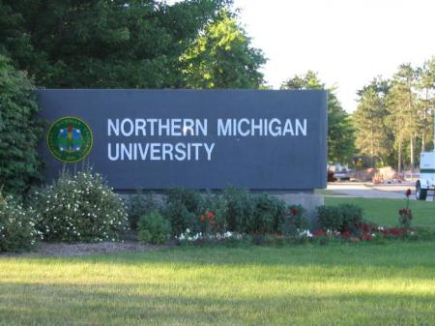
Universitys in Michigan
Northern Michigan University
Oakland University
Central Michigan University

Slide 7

Picking a University
Honestly I have no clue what collage I want to go to! The ones that I am looking at is Northern University and Oakland University. Even though this one wasn’t even on my mind. I have officially decided that I want to go to Central Michigan University, CMU.

Slide 8


Who am I?
I am an athletic, hard working, dedicated teenager. I love sports. I play volleyball, basketball, and track & field. When I m not practicing I'm riding my own horse. I have always wanted to be able to save lives. I love helping people.
I plan on attending Central Michigan University to study Histotechnology. When I go to collage I will be leaving behind all of my friends, family and job, but they will be able to come and visit me when I am there. That’s the good thing.

Slide 9
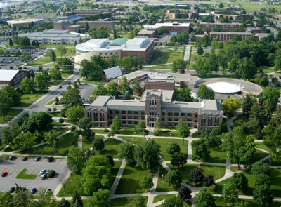
In the end
So that is what I plan on doing when I get out of High School and in to life, I will be attending Central Michigan University in Mount Pleasant, Michigan. Honestly, to me, it sounds really scary!

Slide 10
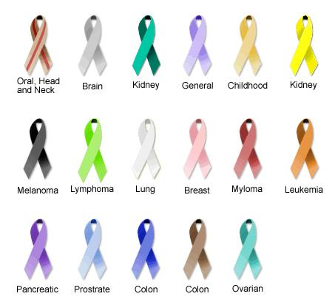
All The Ribbons For Cancer =]

Slide 11
University Links
Central Michigan University
http://google.cmich.edu/search?q=histotechnology&x=47&y=16&entqr=0&ud=1&sort=date%3AD%3AL%3Ad1&output=xml_no_dtd&oe=UTF-8&ie=UTF-8&client=default_frontend&proxystylesheet=default_frontend&site=default_collection
Northern University
http://webb.nmu.edu/SiteSections/Search/KeywordSearch.shtml?search=histotechnology&cx=008043451410798037363:ligvx6uvsk4
Oakland University
http://www.oakland.edu/apps/searchou/default.aspx?cx=017797428627749203211:osdmnaba-js&cof=FORID:11&ie=UTF-8&q=histotechnology#913

